Slide 1
Interactive Crypto Portfolio Analyzer and Arbitrage Dectection
Project 1, Group 5 - Bakary Sylla, Yadisa Joiner, Marcus LeGare, Patrick Jones

Slide 2
AGENDA
Executive summary
Data Collection, Cleanup & Exploration
App Design Methodology
Results and Conclusions
Next Steps

Slide 3
Executive summary
Use an interactive web GUI
Analyze the risk indicators of crypto currencies
Multiple crypto currencies are traded on several crypto exchanges
Uncover patterns in the crypto market price data
Detect arbitrage opportunities

Slide 4
Data Collection, Cleanup & Exploration
Source data file: historical single crypto csv file
10 crypto currencies, 5 crypto exchanges, hourly price from 7/23/2013 to 7/31/2019
Use pandas to build an on-demand dataframe
DF includes only the daily closing prices for each crypto currency on all the five exchanges
Avoid using pandas dropna() function to get better insight into the dataset

Slide 5
App Design Methodology
IDE:
VSCode
New packages:
dash, dash bootstrap components, plotly express
Main directory
app.py - main module
Build an interactive web GUI with dropdown menu
Call the processing module and plot the resulting graph
Allow user to interact with the graph using a toolbar
Provide tooltips for additional description of the axes and data of the graph

Slide 6
App Design Methodology
Data subdirectory
crypto.csv
Utils subdirectory
data_prep.py : clean up and prepare on demand dataframe based on user input cryptocurrency
sharpe_ratio.py : rolling window sharpe with selectable window size and selectable crypto currency
daily_returns.py : rolling window daily returns with selectable window size and selectable crypto currency
arbitrage.py : rolling window closing prices of selectable crypto currency on exchanges

Slide 7
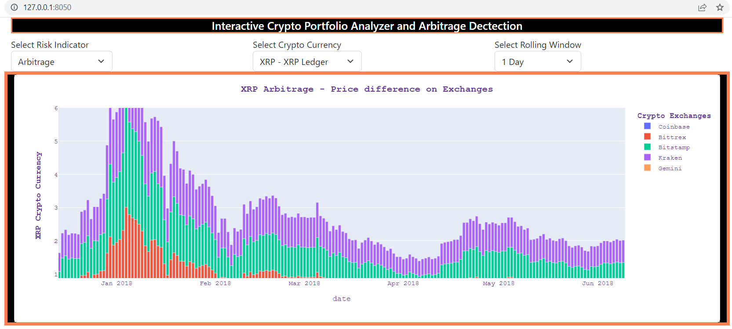
RESULTS and conlcusions
Interactive GUI ( do a live demo)

Slide 8
cONCLUSIONS
Live demo - Run the app and analyze the data for the following
What is the best exchange to buy crypto?
What is the best exchange to sell crypto?
What is the crypto with the best sharpe ratio on what which exchange?
What is the most volatile crypto on which exchange?

Slide 9
Next steps
Allow users to zoom in the data by selecting smaller interval of time
Extend the interactive analysis to the stock market and bond market
Include forecasting such as Monte Carlo simulation
Provide options for users to set investment goals and build build automated portfolios accordingly

